Slide 1
CIS 700-004: Lecture 12M
Hyperparameters and learning to learn
04/01/19
Notes:
Done

Slide 2
Agenda
Course announcements
Project reminders
New grading policy
How to tune hyperparameters
Learning rate and batch size
Selection methodologies
Bayesian optimization
Population-based training
Meta-learning
Multi-task learning

Slide 3
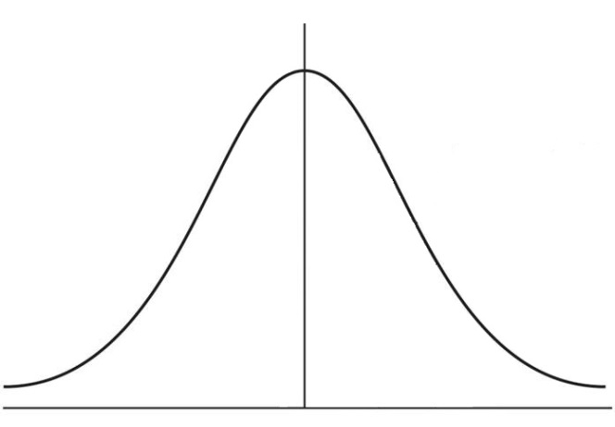
New grading scheme
Curved
In the limit of large N, there is less variance between years with curving
10% A, 40% B, 40%C, 10% F
Approximately normal
A
F
Notes:
Done

Slide 4
New grading scheme
Curved
In the limit of large N, there is less variance between years with curving
10% A, 40% B, 40%C, 10% F
Approximately normal
A
PRIL
F
OOLS
Notes:
Done

Slide 5
Optimizers
Notes:
Done

Slide 6
Not Jeffrey: Adam vs SGD?

Slide 7
Why should there be optimizers in the brain?
Clearly the brain is multi objective
Curiosity
Fun
Food
Coffee
Evolving a system may be hard
Modularization makes evolution easier
Notes:
Done

Slide 8
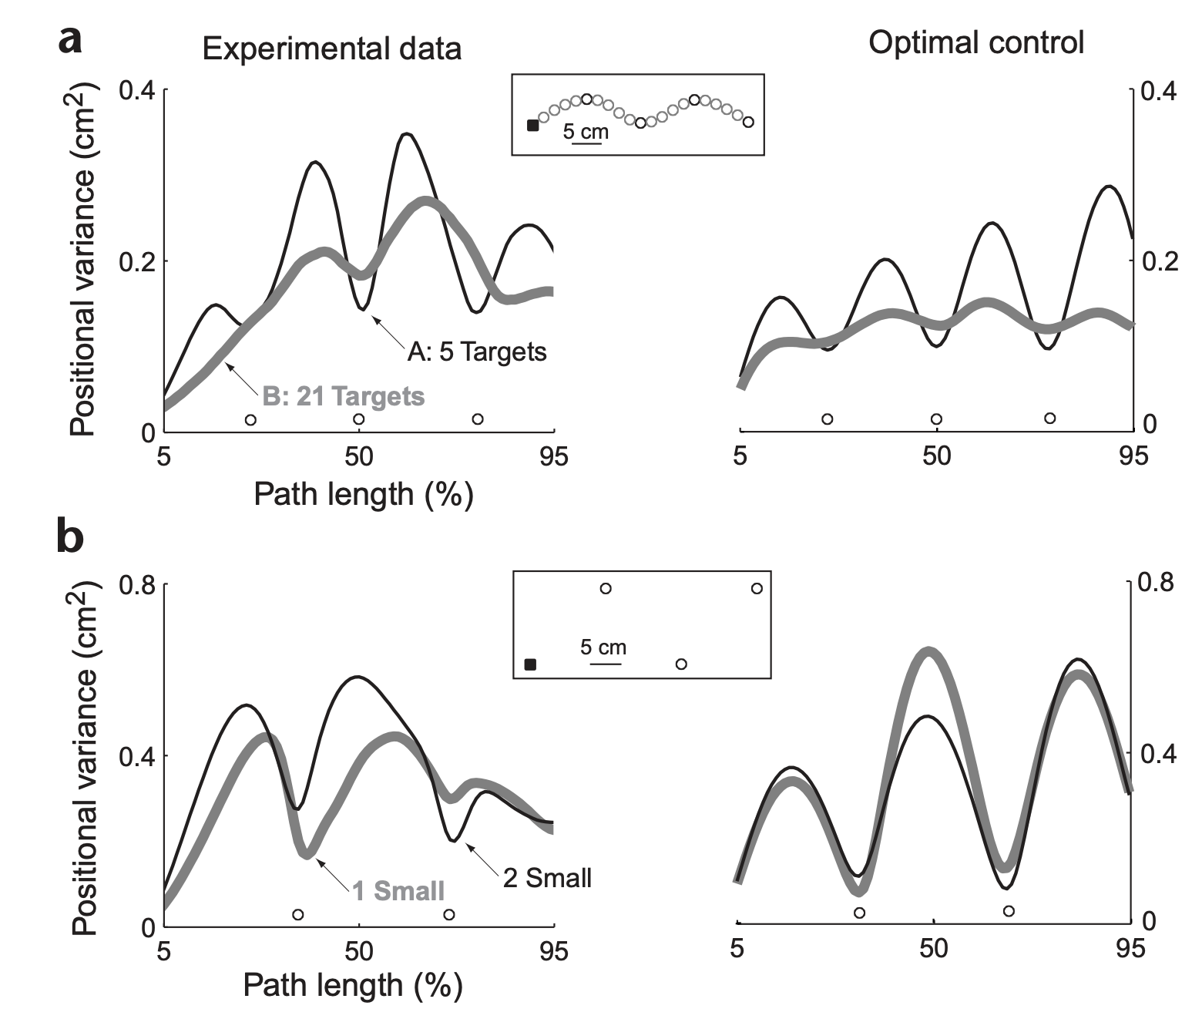
Humans are pretty
good at optimization
Todorov and Jordan 2002
Notes:
Done

Slide 9
Learning rate and batch size
Notes:
Done

Slide 10
What do larger mini-batches do?
Decrease stochasticity in the gradient updates
Increase ability to parallelize
In practice, people have often used largest mini-batches allowed by memory
Increases speed of training
But now realizing this also decreases test accuracy
Why is this?
Smaller mini-batches can find wider, more robust optima - better generalization
Notes:
Done

Slide 11
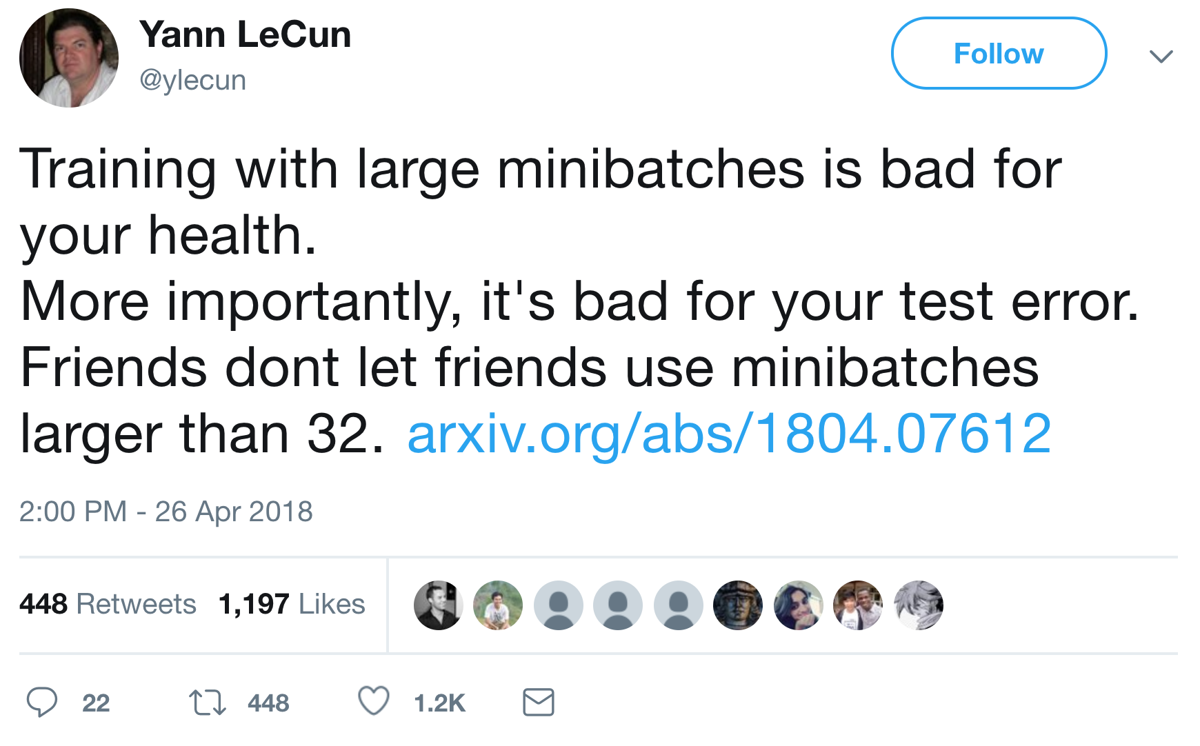
So what is the answer?
No solid answer yet, but some experienced opinions
Some controversy about this
Notes:
Extra points for being the only person, worldwide, who does not follow yann

Slide 12
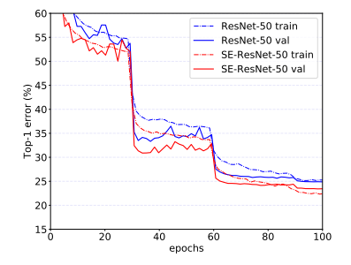
What about a larger learning rate?
Easier to find global optima rather than just local optima
But also harder to converge to any minimum
Often people use learning rate decay - dropping the learning rate on a fixed schedule (= a type of simulated annealing)
Pre-written functions for this in PyTorch, Tensorflow
Why you see curves like this:
Notes:
Done

Slide 13

Context for learning rate decay: simulated annealing
Finding the global maximum with simulated annealing
As temperature goes down, exploration decreases
Notes:
Done

Slide 14
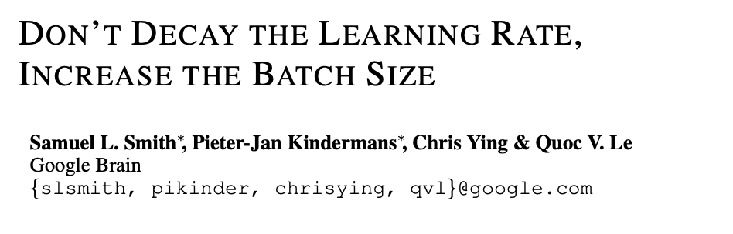
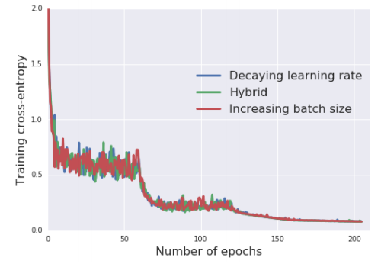
Relationship between batch size and learning rate
Increasing the batch size is kinda like decreasing the learning rate
Smith et al. recommend since bigger batch sizes make training faster
“train ResNet-50 on ImageNet to 76.1% validation accuracy in under 30 minutes”
Notes:
Done

Slide 15
Relationship between batch size and learning rate
Larger batch size allows large learning rate, but exact relationship unclear
Some people think learning rate should scale as batch size
Gradient updates are averaged over a batch: sum of updates / batch-size
By picking learning rate = C * batch-size, get the total update
( C * batch-size) * (sum of updates / batch-size) = C * sum of updates
which doesn’t depend on batch size
Other people think learning rate should scale as sqrt(batch size)
Standard deviation of the mean of N things scales as 1/sqrt(N).
Notes:
Done

Slide 16
Hyperparameter choice
Notes:
Done

Slide 17
What are hyperparameters?
Hyperparameters are parameters/settings that aren’t learned
Essentially capture implicit priors and assumptions
Examples:
Learning rate, batch size
Momentum, other optimizer parameters
Network architecture (width, depth, etc.)
Initialization
Tradeoffs between different loss functions (e.g. L1, entropy)
Lots more
Deep learning is often disturbingly sensitive to hyperparameter choice.
Notes:
Done

Slide 18
Hyperparameters as the targets of evolution
The interpretation of the parameters optimized by evolution
Numbers of neurons
Identities of areas
Learning rules
Optimizers
Cost functions
Notes:
Done

Slide 19
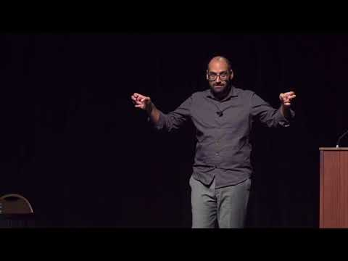
Ali Rahimi “Deep Learning is Alchemy”
Notes:
Done

Slide 20
How to choose hyperparameters?
Popular, basic method: Manual tuning
Try a few things, see what works, tweak it
Simple and very frustrating - takes a long time to iterate
Grid search
Make a grid of possible settings
Test all of them in parallel exhaustively
Fast if you have infinite computers, otherwise not
Wastes a lot of time on unproductive hyperparam settings
Random search
Random points instead of a grid
Surprisingly, as good or better than grid
No guarantees, since random
In practice, though, fewer sample points required
Notes:
Done

Slide 21
Evaluating hyperparameters
Suppose you are trying to optimize your hyperparameters.
What set of data do you use to evaluate them? Training? Test?
Validation set!
This is crucial - using the test set itself can lead to serious overfitting.
This is why datasets have this three-way split.
If they don’t, then you should create it!
I have one collaborator who never even looks at the test set until making the final experiments for publication.
Notes:
Done

Slide 22
Bayesian hyperparameter optimization
10% 19% 21% 19%
15% 29% 46% 25%
21% 52% 67% 45%
35% 72% 89% 75%
Notes:
Done

Slide 23
Bayesian hyperparameter optimization
10% 19% 21% 19%
15% 29% 46% 25%
21% 52% 67% 45%
35% 72% 89% 75%
Notes:
Done

Slide 24
Bayesian hyperparameter optimization
Test some hyperparameter choices
Estimate how choices affect performance
Make more choices in a way that might increase performance
Repeat
Grid search and random search are simultaneous (lots of compute at once)
Bayesian optimization is sequential (more time, less overall compute)
Notes:
Done

Slide 25
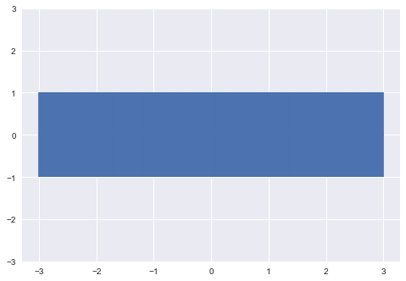
Gaussian processes
Notes:
https://blog.dominodatalab.com/fitting-gaussian-process-models-python/

Slide 26
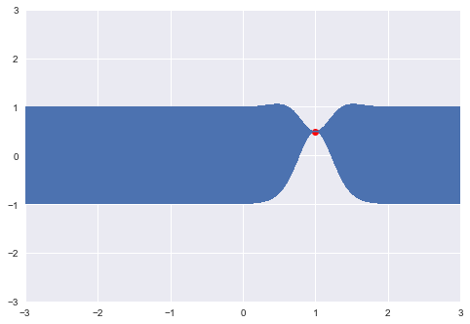
Gaussian processes
Notes:
https://blog.dominodatalab.com/fitting-gaussian-process-models-python/

Slide 27
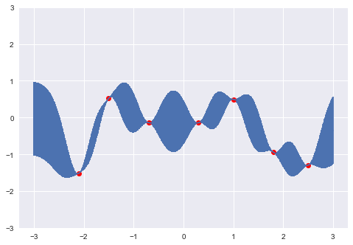
Gaussian processes
Notes:
https://blog.dominodatalab.com/fitting-gaussian-process-models-python/

Slide 28
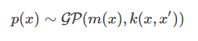
Gaussian processes
Notes:
https://blog.dominodatalab.com/fitting-gaussian-process-models-python/

Slide 29
This computation is feasible because of marginalization.
Notes:
https://blog.dominodatalab.com/fitting-gaussian-process-models-python/

Slide 30
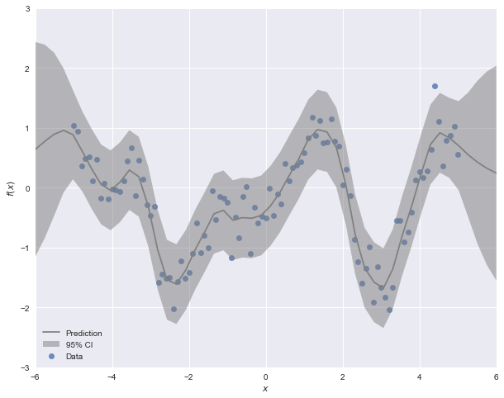
Scikit-learn does Gaussian process regression.
Notes:
https://blog.dominodatalab.com/fitting-gaussian-process-models-python/

Slide 31
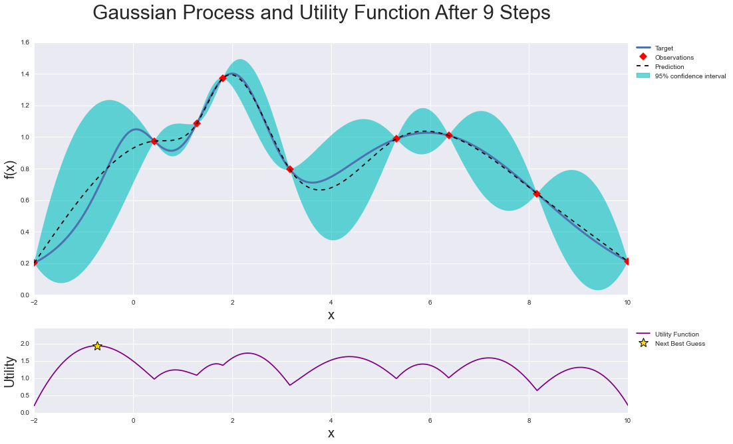
Bayesian optimization uses Gaussian processes and a utility function to make optimization cheap.

Slide 32
This Bayesian optimization package will change your life.
Repo: https://github.com/fmfn/BayesianOptimization
Basic tutorial: https://github.com/fmfn/BayesianOptimization/blob/master/examples/basic-tour.ipynb
Visualization: https://github.com/fmfn/BayesianOptimization/blob/master/examples/visualization.ipynb
A survey of Bayesian optimization methods: https://arxiv.org/pdf/1012.2599.pdf

Slide 33
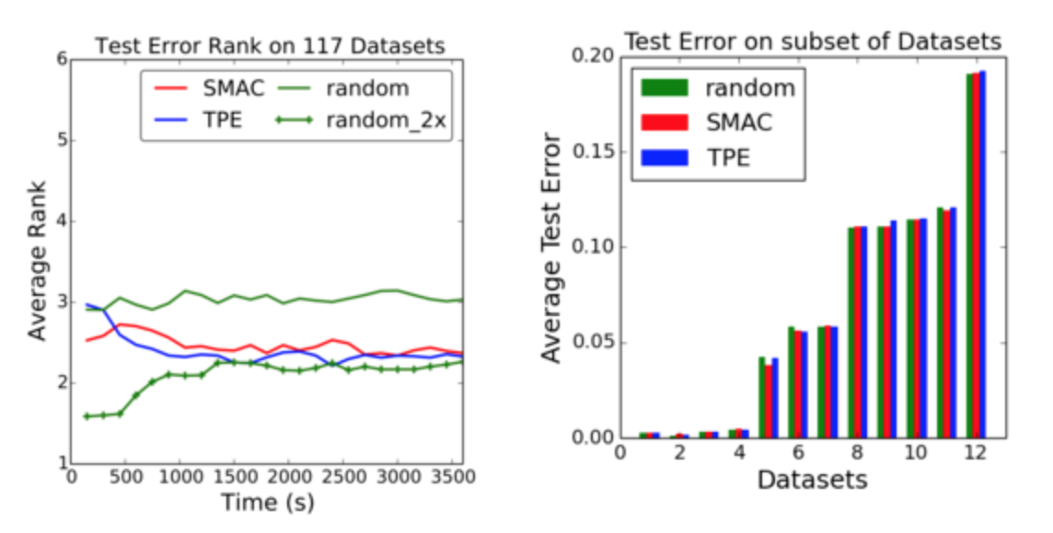
Are Bayesian methods actually better?
Kevin Jamieson and Ben Recht (2016):
Notes:
Done

Slide 34
Are Bayesian methods actually better?
For lots of hyperparameters, random search might be just as good.
“Why is random search so competitive? This is just a consequence of the curse of dimensionality. Imagine that your space of hyperparameters is the unit hypercube in some high dimensional space. Just to get the Bayesian uncertainty to a reasonable state, one has to essentially test all of the corners, and this requires an exponential number of tests. What’s remarkable to me is that the early theory papers on Bayesian optimization are very up front about this exponential scaling, but this seems to be ignored by the current excitement in the Bayesian optimization community.”
Bayesian methods should be good for high resolution, but low dimensionality
Notes:
Done

Slide 35
Population-based training (PBT)
Introduced by Max Jaderberg, DeepMind in 2017
If you really want to parallelize
Used by places with lots of compute
A type of genetic algorithm
Instead of having many sequential runs, all the evolution during a single training run
Simultaneous like grid search, but similar to sequential techniques like Bayesian
Notes:
Done

Slide 36
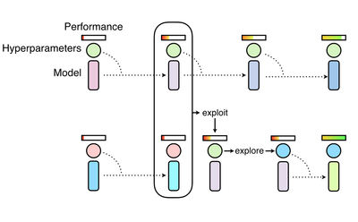
Population-based training (PBT)
“Population” of learners with different hyperparams
Periodically, weaker learners are overwritten
Better-performing ones are copied (=exploitation)
Both weights and hyperparams copied exactly
The copied hyperparams are varied slightly as training continues (=exploration)
Overall, the population moves towards better hyperparam settings
End up with schedules for all the hyperparameters - changing over the course of training.
Notes:
Done

Slide 37
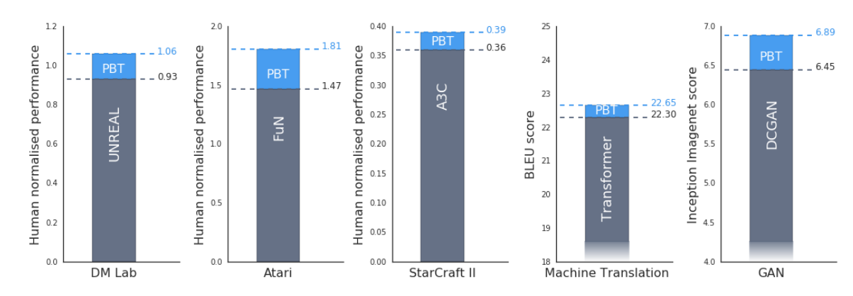
Population-based training (PBT)
Notes:
Done

Slide 38
Metalearning
Notes:
Done

Slide 39

Metal-earning?
Notes:
Done

Slide 40
Multi-task learning, transfer learning, & meta-learning
In multi-task learning, we have to learn many different tasks
E.g. playing tennis, playing badminton, playing squash
Transfer learning involves training on one task to improve learning on another
Shared data representations, for example
Example: pre-training on ImageNet
Meta-learning = Learning to learn uses the first task to learn how to learn the second task
But people sometimes use meta-learning and transfer learning synonymously :)
Notes:
Done

Slide 41
Meta-learning = Learning to learn
Learning how to learn new things fast
Often tested using one-shot learning and few-shot learning
True one-shot learning is generally impossible
(Unless you use Capsule Nets or other unsupervised methods)
But can learn from how you learned the previous tasks

Slide 42
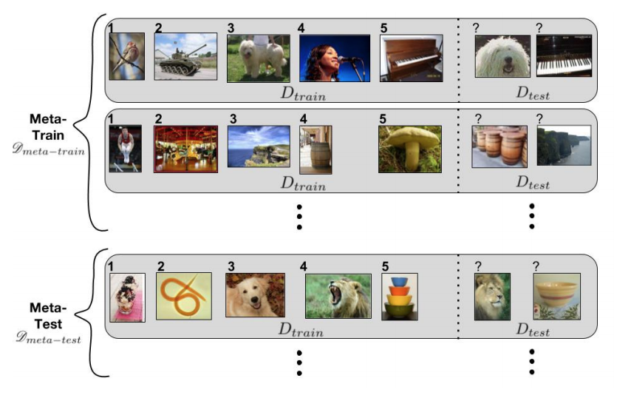
Meta-learning / learning to learn
Notes:
Done

Slide 43
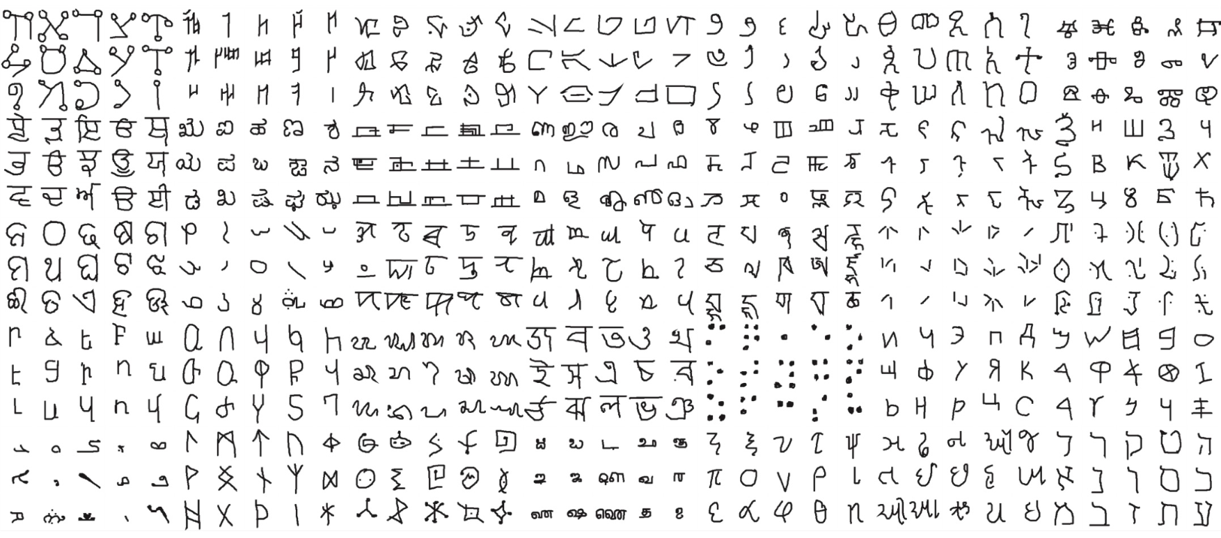
Omniglot dataset
50 alphabets, many handwritten examples of each letter
Train on most alphabet, then see how fast to learn a new one
One-shot = just one example of each new letter
Notes:
Done

Slide 44
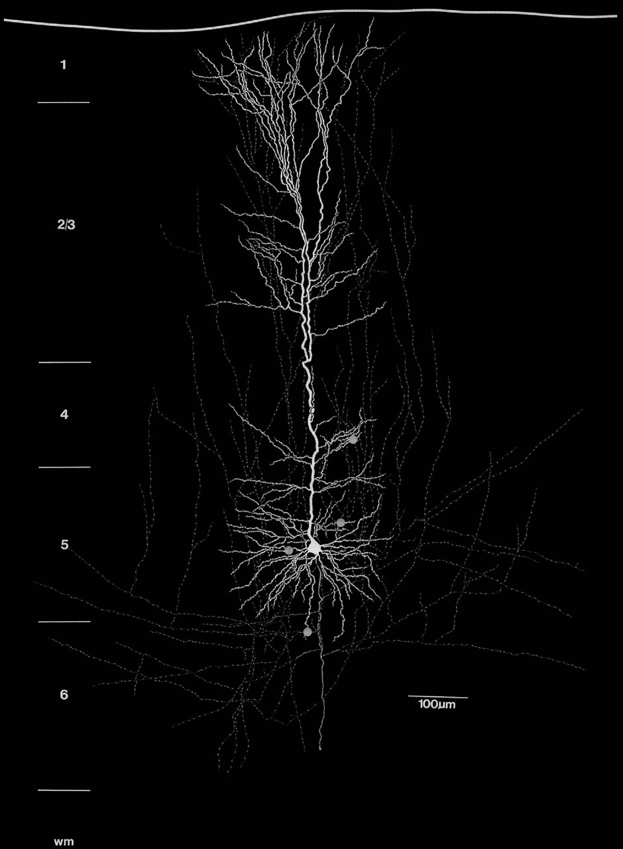
Meta-learning
in the brain!
Notes:
Done

Slide 45
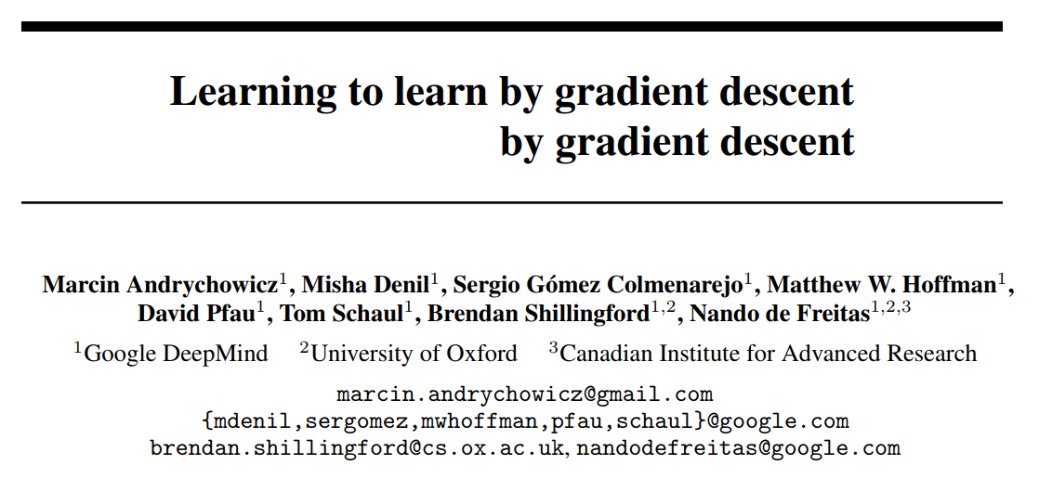
Learning to learn

Slide 46
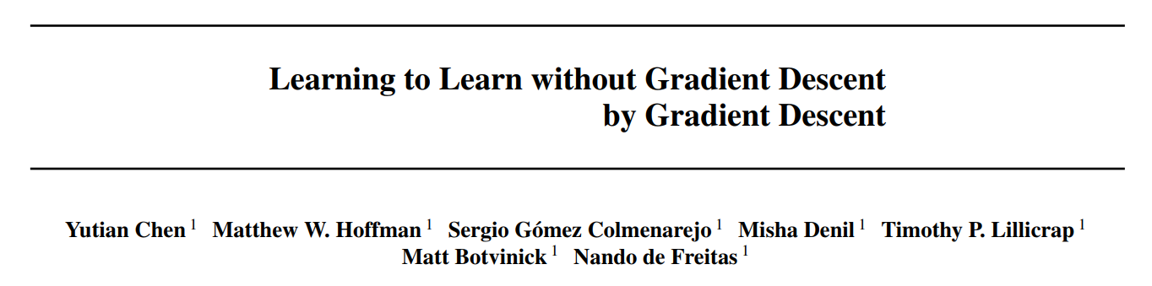
Learning to learn, cont.

Slide 47
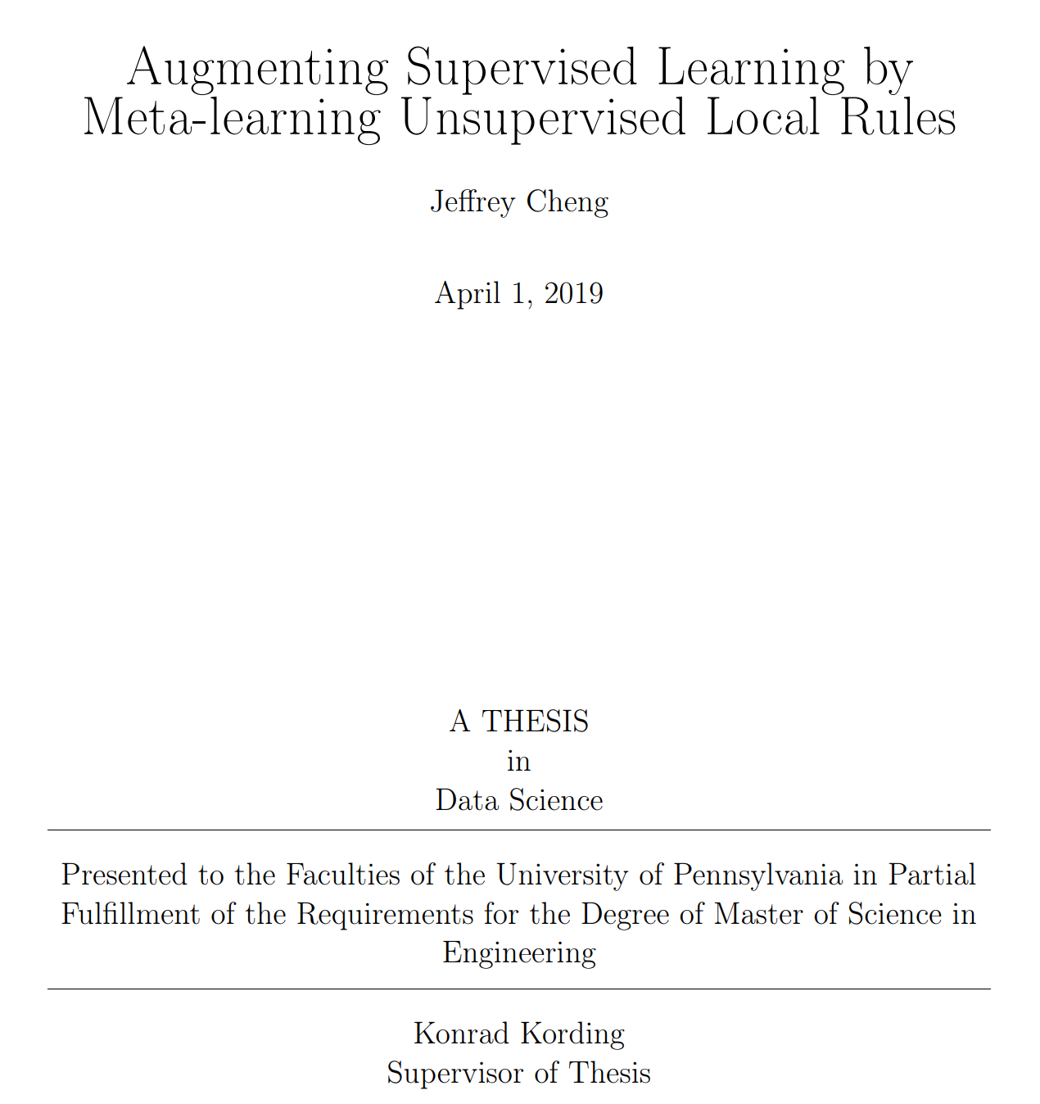
Learning to learn, cont., cont.

Slide 48
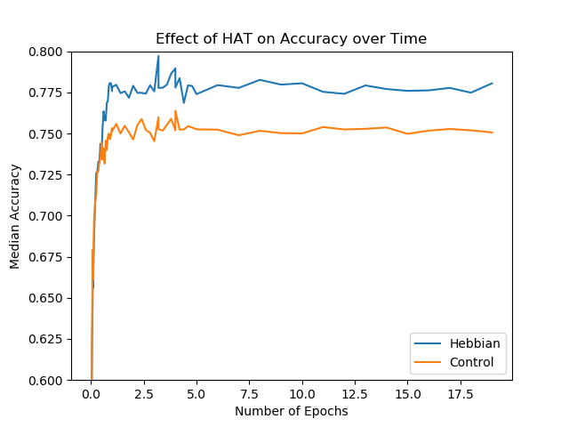
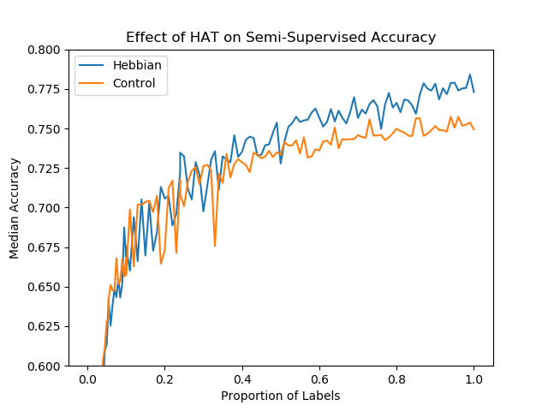
Learning unsupervised local update rules improves convergence in parameter space...

Slide 49
Learning unsupervised local update rules improves convergence in parameter space...
… and might give some insight into the actual rule that our neurons use.

Slide 50
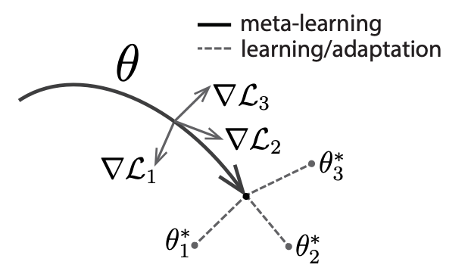
Model-agnostic meta-learning (MAML)
Introduced by Chelsea Finn in 2017
Lots of variations
Basic idea: optimize for parameters that are close to the optima for different tasks
Notes:
Done

Slide 51
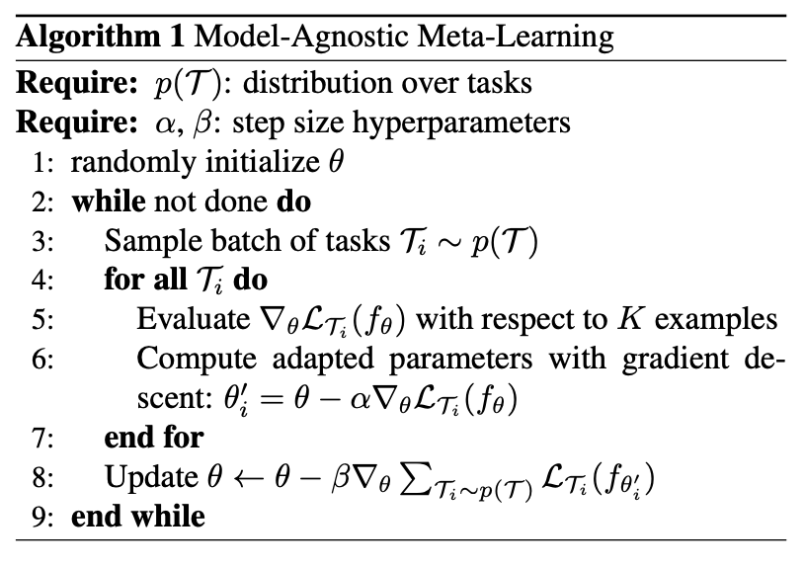
Model-agnostic meta-learning (MAML)
Notes:
Done

Slide 52
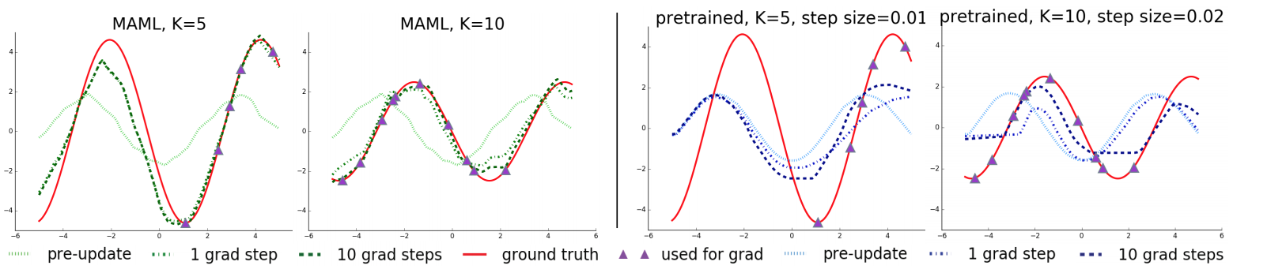
Model-agnostic meta-learning (MAML)
Here, the algorithm has learned about the structure of sine waves
It can learn a new sine wave after just one gradient update
Even if the sample points are on only part of the curve
Notes:
Done

Slide 53
Second-derivative calculations
Implicit in MAML is a calculation of a gradient of a gradient
This was naively require computing (# weights)^2 terms.
Instead, can approximate the second derivative with finite differences:

Slide 54
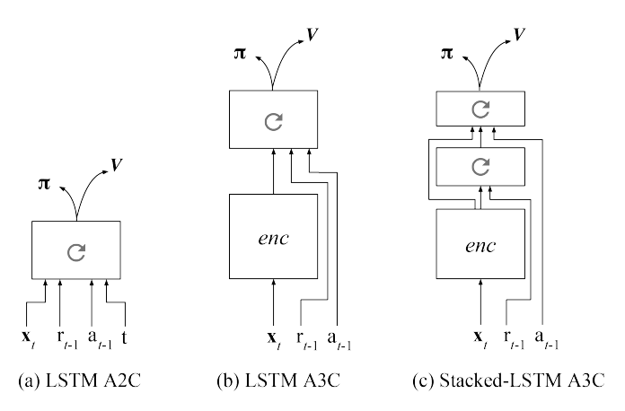
Learning to reinforcement learn
Jane Wang, DeepMind 2017
Simply train an LSTM to do some RL tasks (A3C = async. advantage actor-critic).
Once weights learned, don’t change anymore.
Then use trained LSTM to learn a new task.
The LSTM is able to learn a (simple) new task, without changing the weight.
The “learning” occurs in the hidden states.
Notes:
Done

Slide 55
Learning to reinforcement learn
A cool (simple) example:
META-TRAINING: Network sees two images, has to pick left or right
Say, the dog is always correct, the cat is always wrong, regardless of position
Once the network has learned to do this, the weights are frozen
META-TESTING: The images change to something different
Now, the fish is always correct, the turtle is always wrong
The network learns to do this (without changing weights)
Can learn after just one pair of images
Notes:
Done

Slide 56
Issues with multi-task learning
Notes:
Done

Slide 57
Interference between tasks
Constructive/destructive interference (aka “positive/negative transfer”)
= learning the tasks together becomes easier/harder
Constructive interference:
Learning tennis + badminton + squash
Destructive interference
Driving on the left side + driving on the right side
Or if the model has very small capacity and simply can’t learn many things at once
Notes:
Done

Slide 58
Catastrophic forgetting
Not a function of the tasks themselves - a function of training
Train on one thing, then train on another
If the data distribution has shifted, forget the first thing
Suppose train on MNIST, but first with all 0s, then with all 1s, etc.
If you can just shuffle the data, fixes the issue
But sometimes you have to train on streaming data - then it’s a problem
Notes:
Done

Slide 59
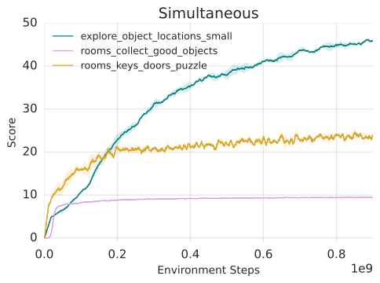
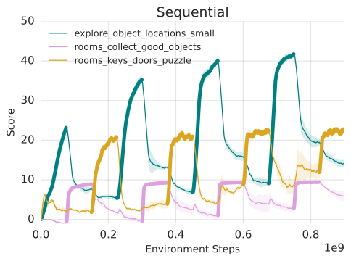
Catastrophic forgetting
Notes:
Done

Slide 60
Methods for fixing forgetting
Synaptic methods:
Identify which weights are important for particular tasks
Freeze learning on those weights while learning other tasks
Replay methods:
Store (some of) the past data
Replay it while learning new data to reduce distribution shift
Inspired by replay in the brain’s hippocampus
Notes:
Done

